Slide 1

Histopathologic Cancer Detection
Team : Team 7 [George Chempumthara and Revanth Padala]
Course : CSYE 7105 High Performance Parallel Machine Learning & AI
Instructor : Prof. Handan Liu

Slide 2
Project Overview
Introduction
Dataset
Data Preprocessing
Multi-CPUs using Joblib
Multi-CPUs using Dask
Base Model
Distributed Data Parallel (DDP) Training Analysis
Fully Shared Data Parallel (FSDP) Training Analysis
DDP vs FSDP
Conclusion

Slide 3
Introduction
Oral Squamous Cell Carcinoma (OSCC) is a serious global health burden, with high morbidity and mortality, requiring early and accurate diagnosis.
Current diagnosis relies on manual examination of histopathological images by pathologists highly accurate but slow, labor-intensive, and subject to inter-observer variability.
Deep learning, especially CNN-based models, offers a way to automatically analyze these images, enabling faster, more consistent, and scalable OSCC detection.

Slide 4
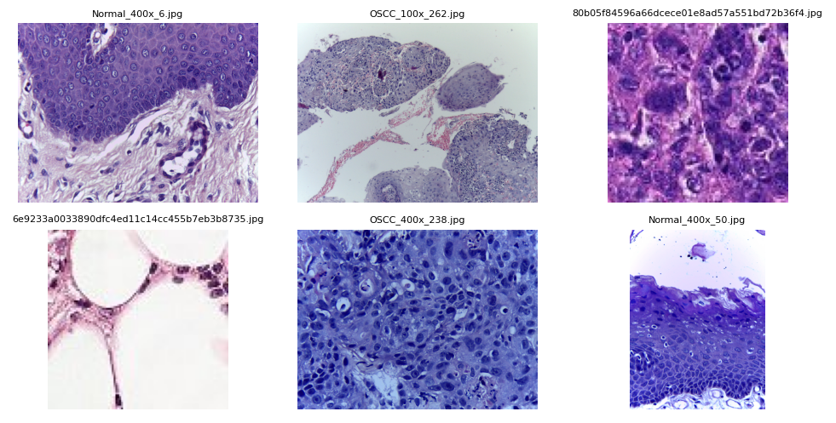
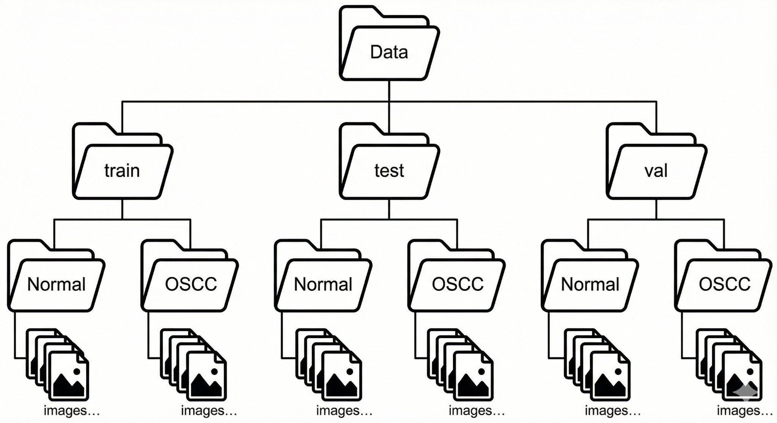
Dataset Overview
Two Public OSCC Histopathology Datasets Combined
Total Images: 314,144
Original Image Sizes Are Heterogeneous (Unbalanced Resolutions)
Total Data Volume: 12GB

Slide 5
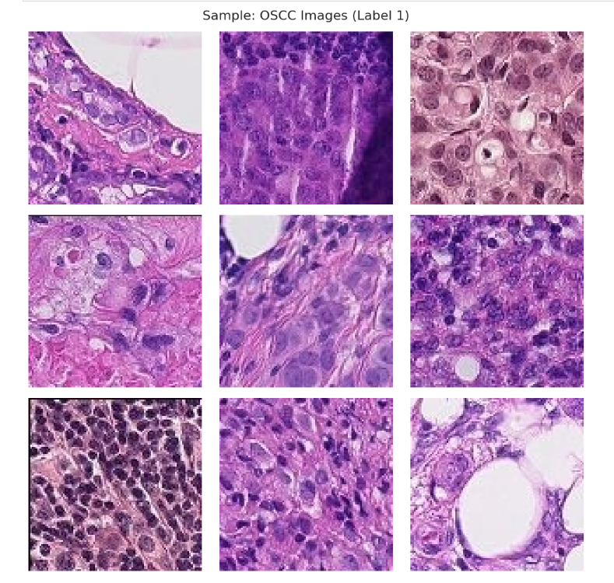
Data Preprocessing
Preprocessed to 96×96
Converted all Images to jpg
Created CSV File with ID and Label
Dask
JobLib
Balancing Data

Slide 6
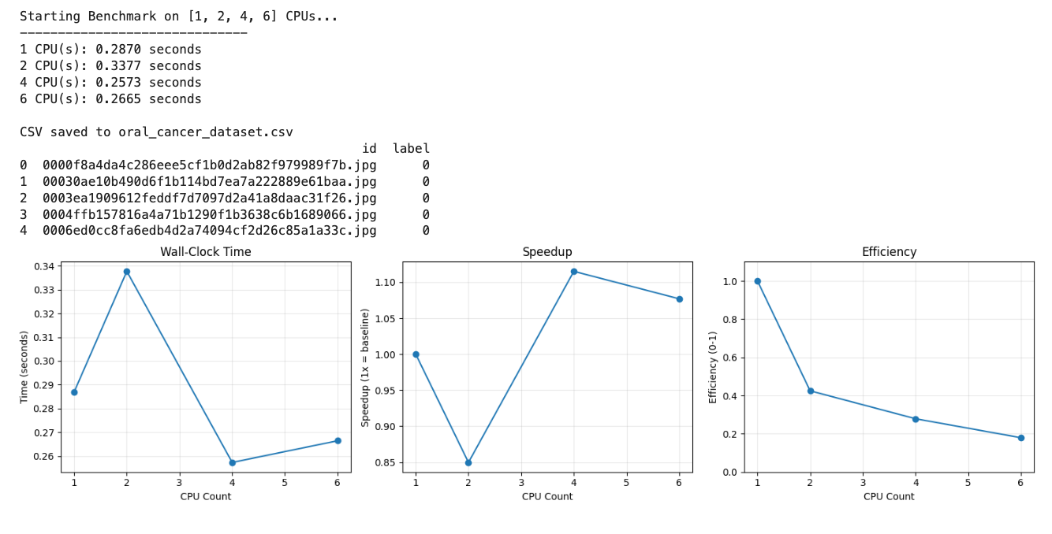
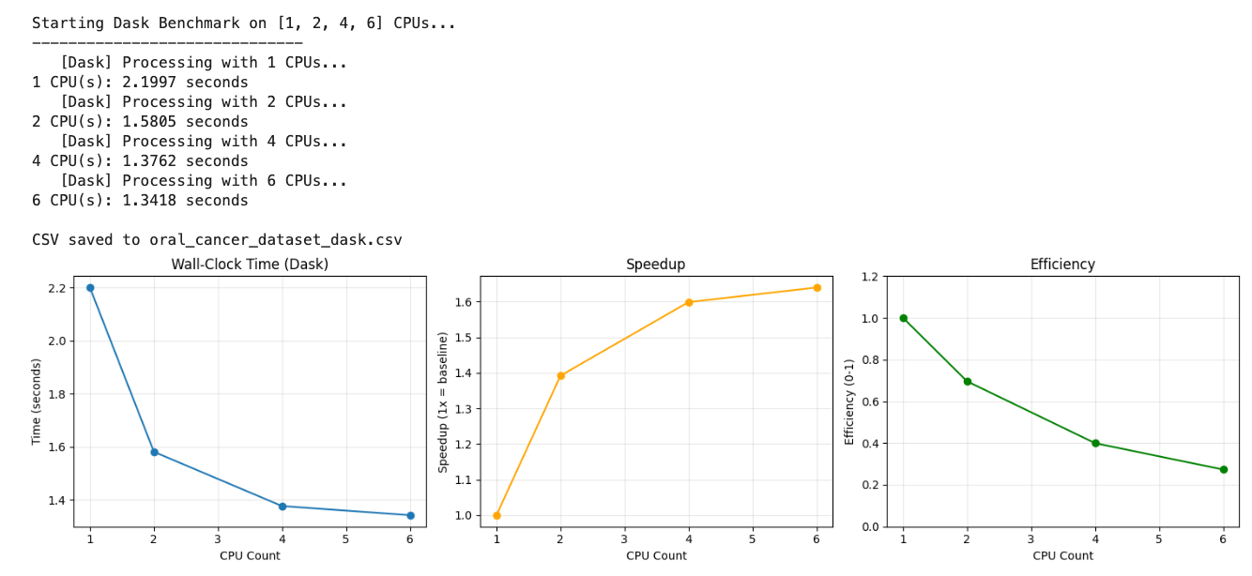
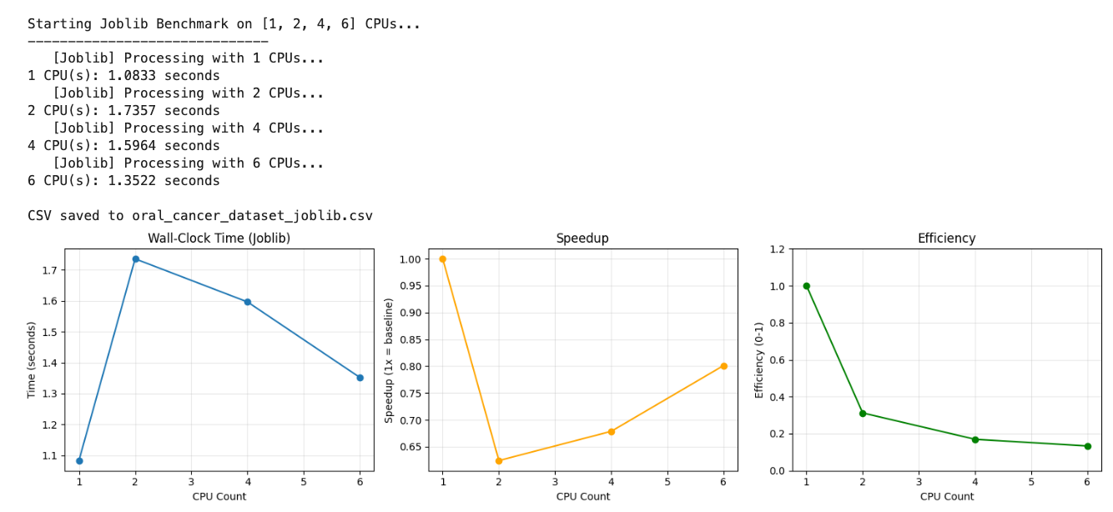
CSV Creation Comparison
Regular MP: Dask:
JobLib:

Slide 7
Performance Comparison
Framework | Best CPUs | Time (Sec) | Speedup
Sequential | 1 | 0.2870 | 1.00x
Regular MP (Best) | 2 | 0.2573 | 1.12x
JobLib (Best) | 1 | 1.0833 | 0.26x
Dask (Best) | 6 | 1.3418 | 0.21x

Slide 8
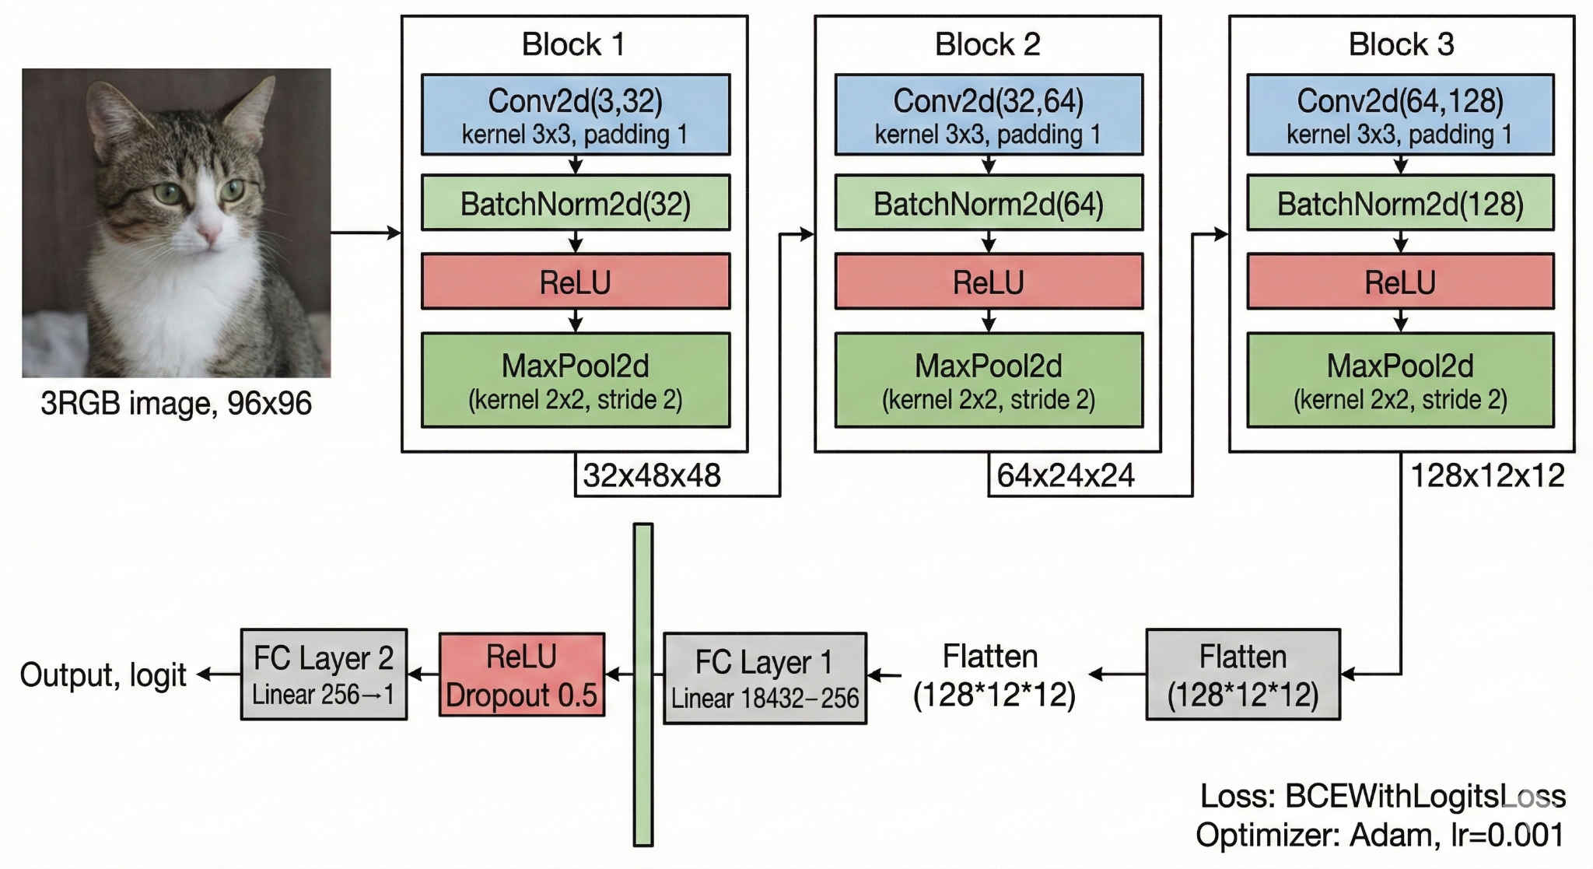
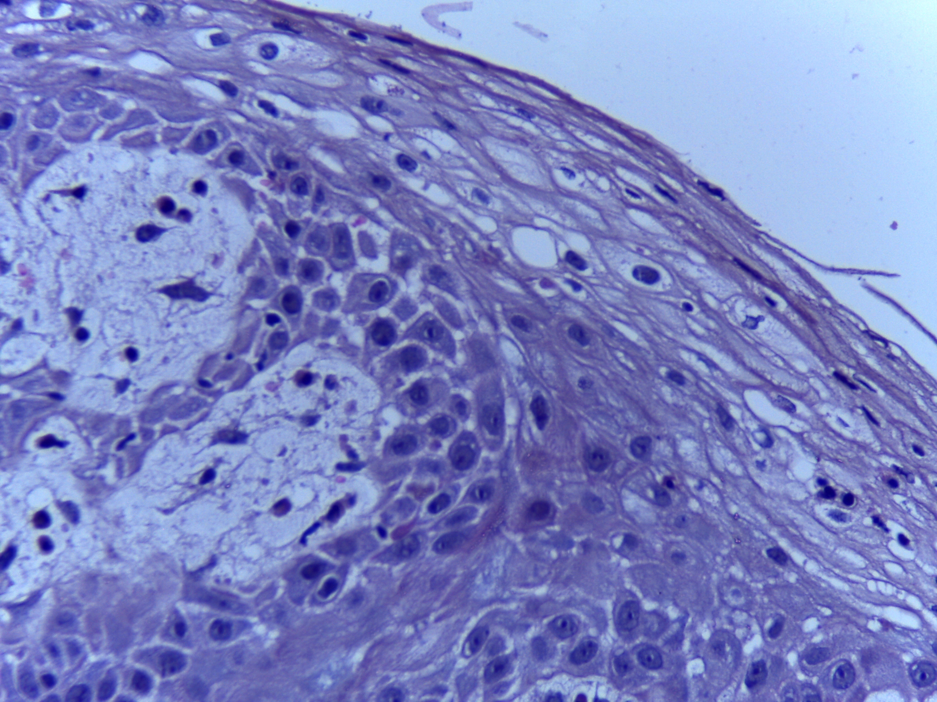
Base Model
Layer Type | Details
Input | RGB IMG, 3x96x96
Conv Block 1 | Conv2d + BN + ReLu
MaxPool2D | Reduces size to 48x48
Conv Block 2 | Conv2d + BN + ReLu
MaxPool2D | Reduces size to 24x24
Conv Block 3 | Conv2d + BN + ReLu
MaxPool2D | Reduces size to 12x12
Flatten | Maps to 1D Vector (128x12x12 = 18,432)
FC Layer 1 | Linear (18, 432 → 256), ReLu, Dropout(0.5)
Output Layer | Linear (256 → 1)

Slide 9
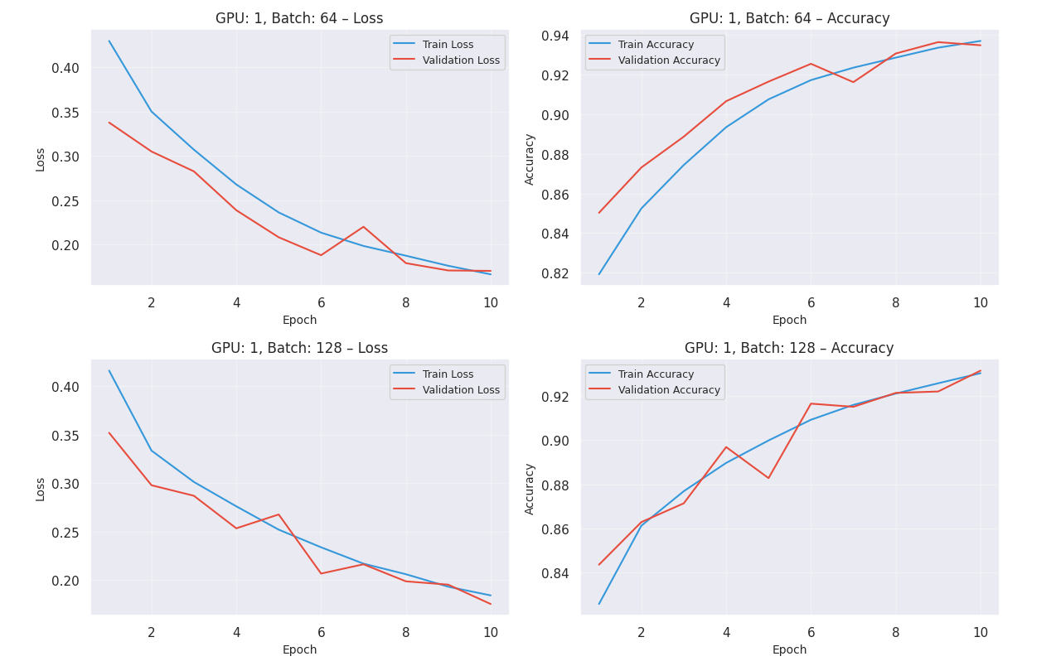
DDP Analysis
Visualizing Learning Curves by GPU Count and Batch Size
GPUs [1, 2, 4]
Batch Size [64, 128, 512]
Epochs - 10

Slide 10
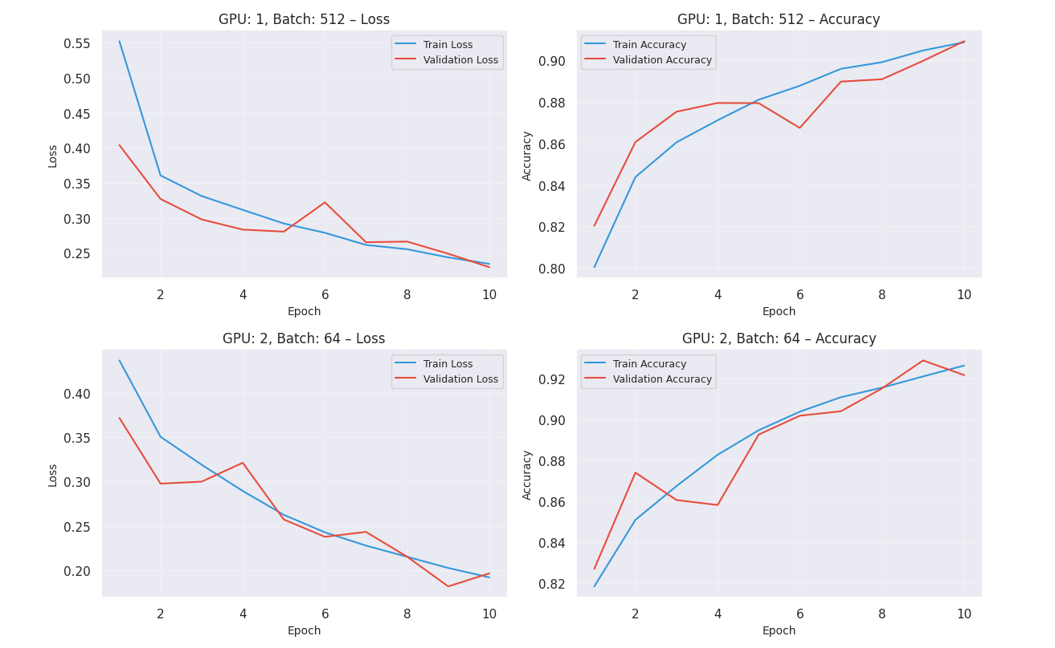
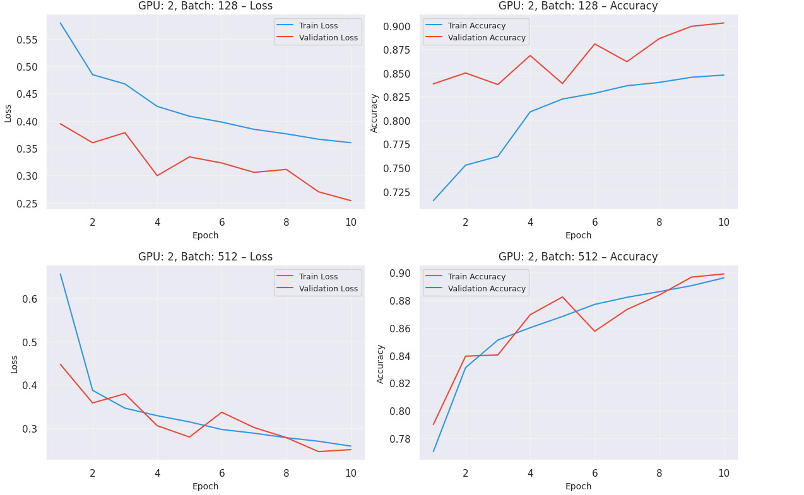
Training, Validation Loss and Accuracy (DDP)

Slide 11
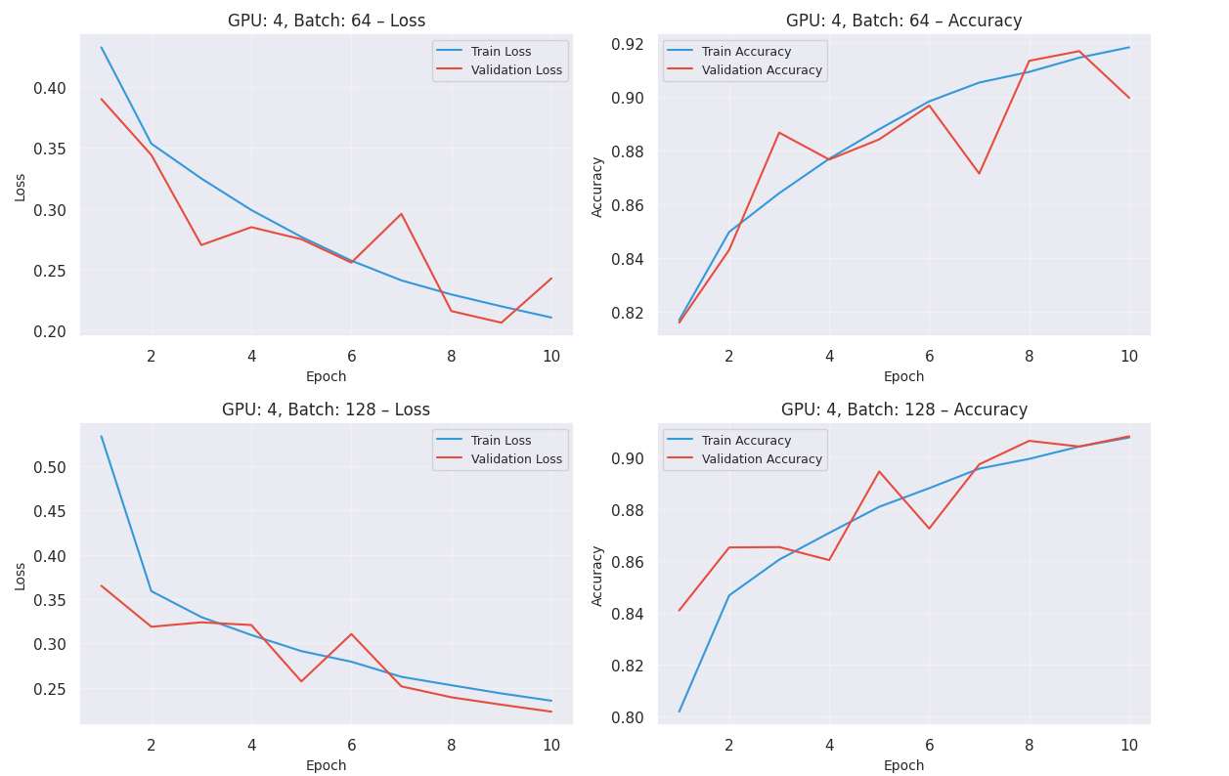
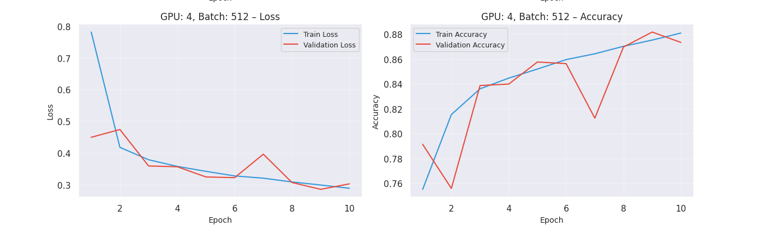
The Generalization Gap: Smaller batches (Batch 64 on 1 GPU) achieved the highest accuracy (~93%) due to the regularization effect of gradient noise, while scaling to larger batches (Batch 512 on 4 GPUs) caused a slight dip in accuracy (89–91%)
Near-Linear Scalability: The Distributed Data Parallel (DDP) backend proved highly efficient, achieving a ~3.7x speedup on 4 GPUs with minimal communication overhead.
Performance Trade-off: The results highlight a fundamental choice: prioritize maximum precision using single-GPU small batches, or maximum speed using multi-GPU large batches.

Slide 12
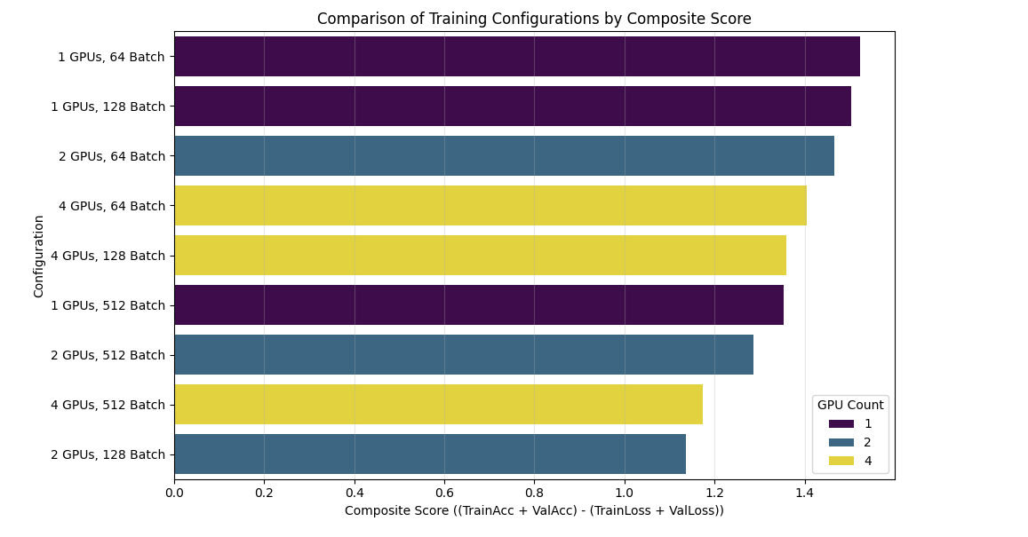
Best Configuration by Composite Score
Golden Config: 1 GPU | Batch 64 - highest composite score (1.12)
Best Quality: Val Acc 88.2%, Val Loss 0.277 → Most accurate and stable
Trade-off: Slowest run (566 img/s) but best generalization
Scaling Effect: 2 GPU - 1170 img/s (2x faster) but accuracy drops to 83-87%
Strategy - Prototype vs Production:
Prototype: 2-4 GPUs → Faster experiments & Hyperparameter tuning
Production: 1 GPU | Batch 64 → maximize safety-critical accuracy

Slide 13
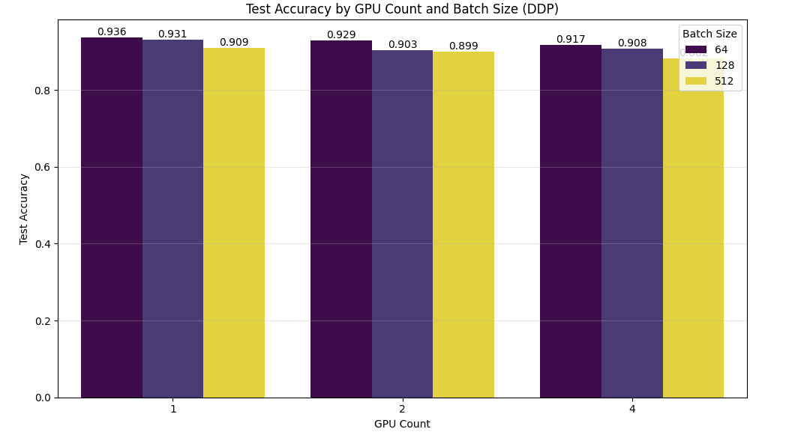
Test Accuracy Across GPU & Batch Size Configuration
Batch Size Effect: Batch 64 consistently outperforms 128; best test accuracy 88.2% (1 GPU Batch 64)
Scaling Patterns: Going from 1 → 2 GPUs, Batch 64 barely drops (0.4%), but Batch 128 drops 4% (to 83.6%)
Diminishing Return: More GPUs + Larger batches → faster training but worst accuracy highlighting a clear generalization gap

Slide 14
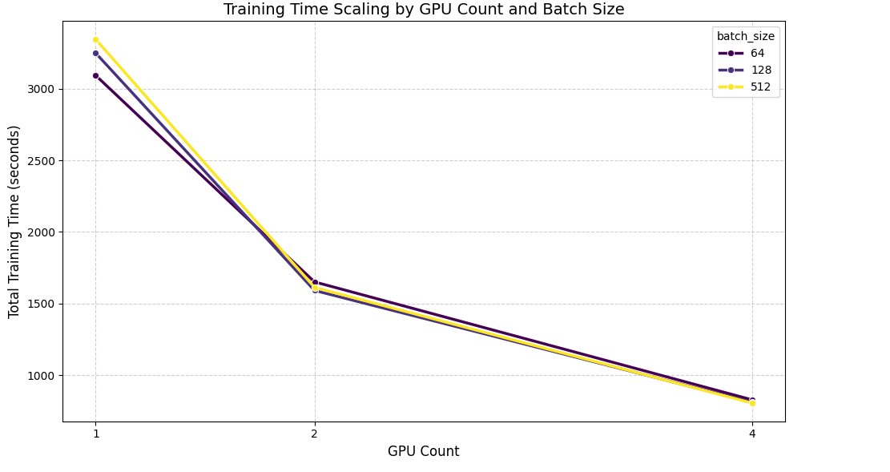
Training Time Scaling With Multiple GPUs
Near-linear 3.73x GPU speedup
51.5 → 13.8 minutes
Diminishing absolute time saving
Big gain: 1 → 2 GPUs
Smaller gain: 2 → 4 GPUs
Batch-size timing converges

Slide 15
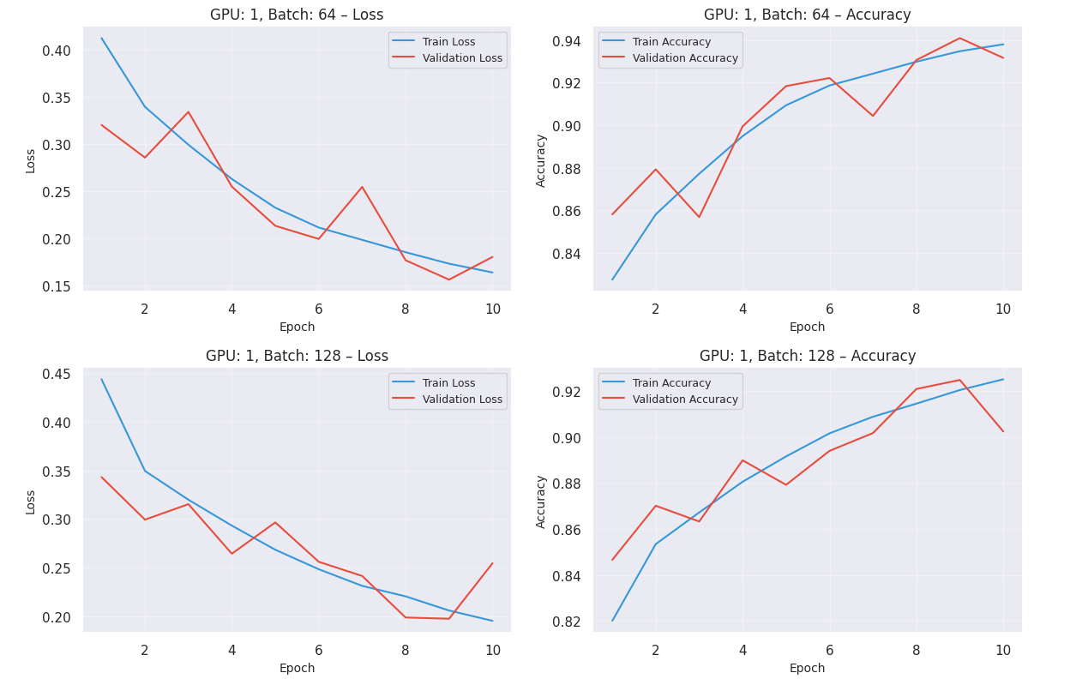
FSDP Analysis
Visualizing Learning Curves by GPU Count and Batch Size
GPUs [1, 2, 4]
Batch Size [64, 128, 512]
Epochs - 10

Slide 16
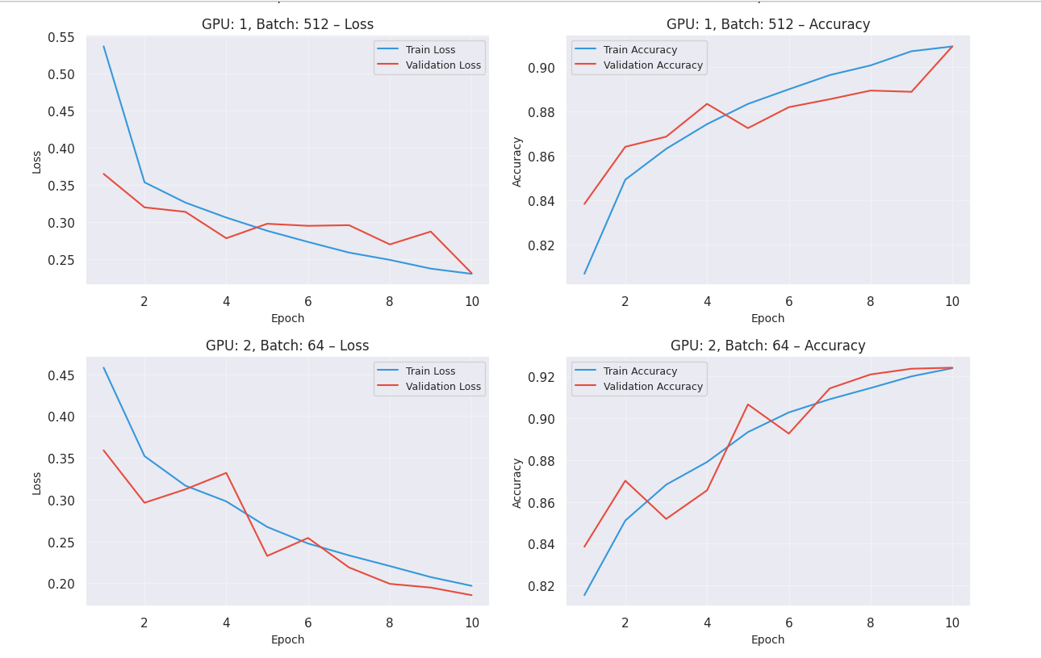
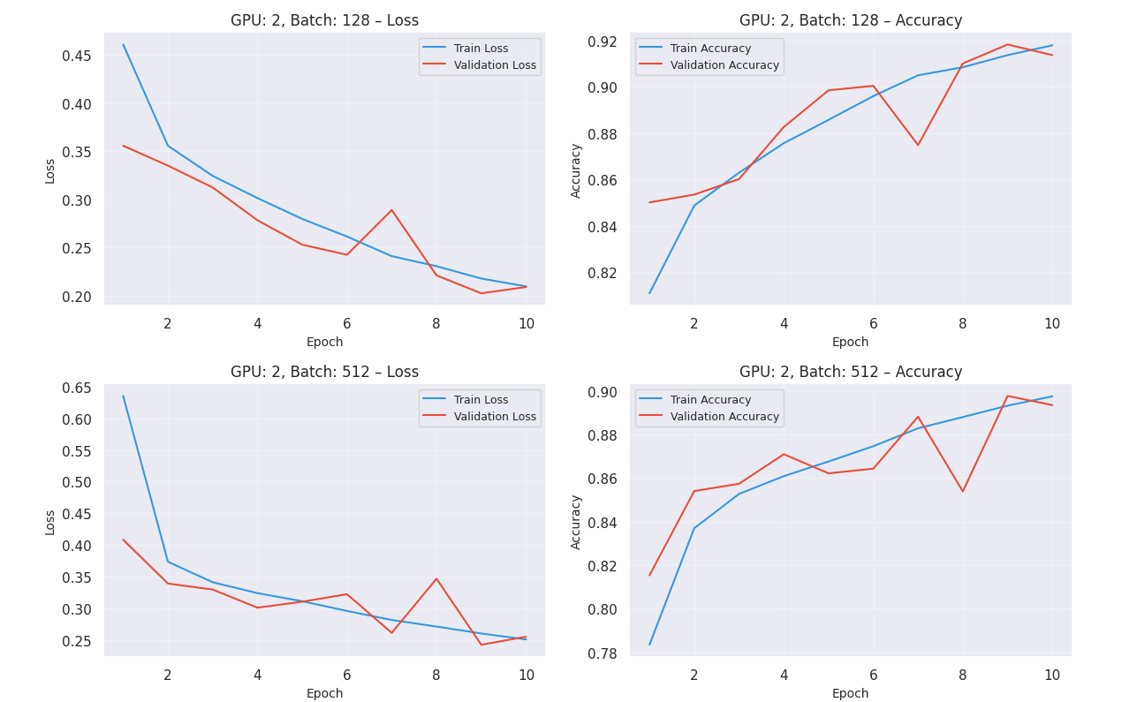
Training, Validation Loss and Accuracy (FSDP)

Slide 17
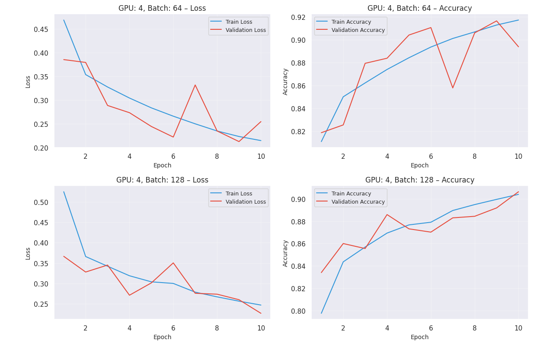
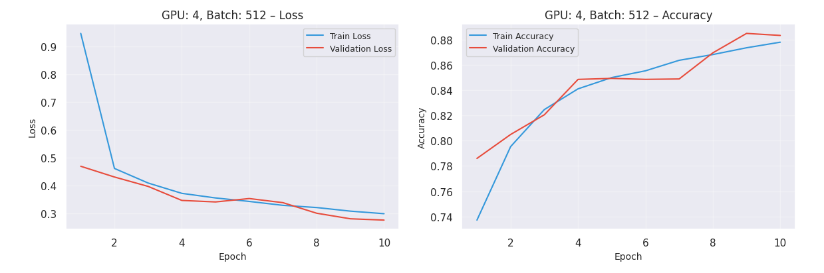
FSDP: 3.4x multi-GPU Speedup
Large batches boost FSDP
4 GPUs | Batch 512: Speed
Batch 64: Accuracy champion
Speed vs Accuracy trade-off

Slide 18
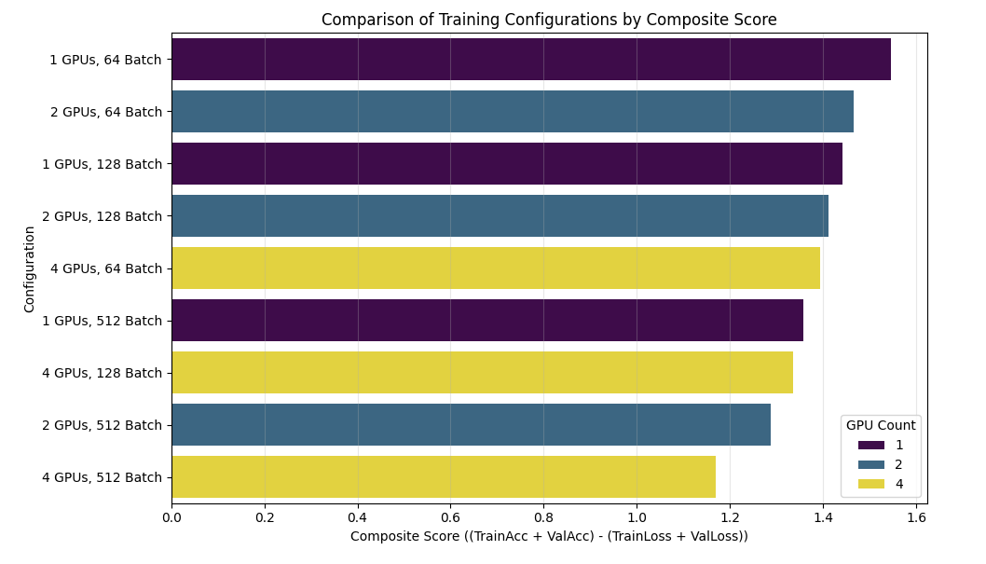
Best Configuration by Composite Score
Golden Config: 1 GPU | 64
Highest quality, best stability
Val Acc 93.4%, loss 0.277
Slowest: 566 img/s
2 GPU: 2x throughput
2 GPU: 90% val accuracy

Slide 19
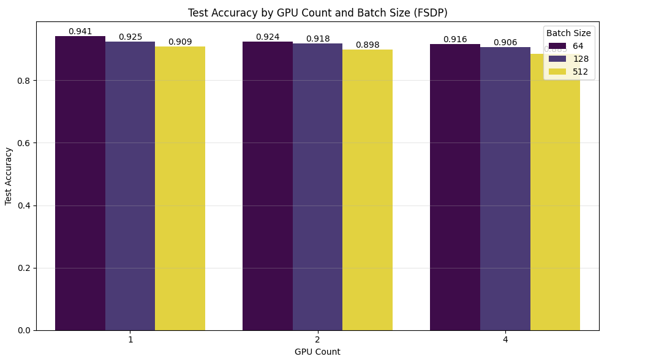
Test Accuracy Across GPU & Batch Size Configuration
Small batches → Best convergence
1 GPU | 64 → 94.1% acc
Batch 128 losses acc
More GPUs → speed, less acc
Final model: Single GPU, Batch 64

Slide 20
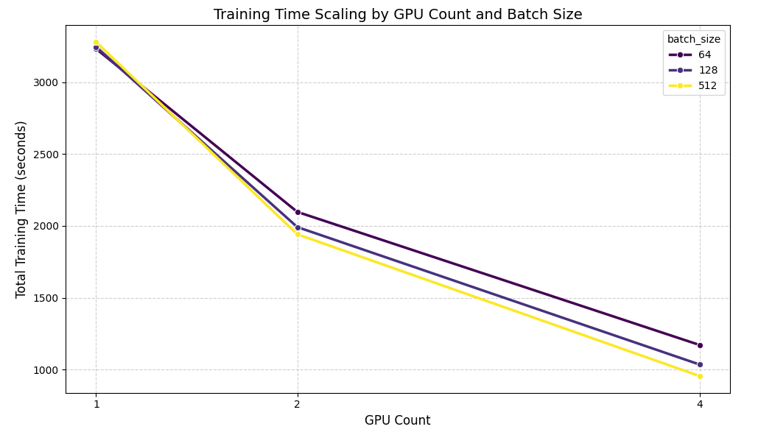
Training Time Scaling with Multiple GPUs
FSDP: 3.43x speedup overall
1 GPU, 512: 3279s
4 GPUs, 512: 956s

Slide 21
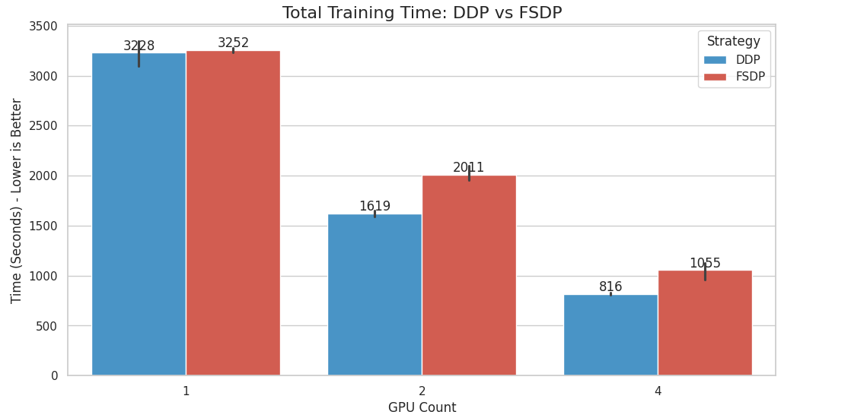
Comparative Analysis: FSDP vs DDP
Observation: Across all multi-GPU runs, DDP was consistently faster, with 4-GPU DDP beating FSDP by 150-343 sec per configuration
For this CNN (fits easily in P100 VRam), FSDP’s sharding overhead isn’t worth it

Slide 22
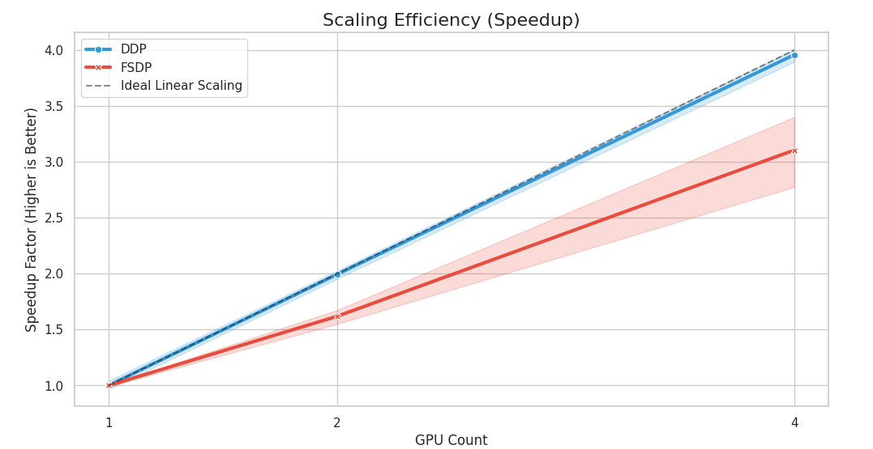
Scaling Efficiency (Speedup)
Observation: Both DDP and FSDP scaled well, but DDP was more efficient, reaching 806s at 4 GPUs vs 956s for FSDP
For this CNN-sized vision workload, DDP’s 3.7x speedup vs FSDP 3.4x

Slide 23
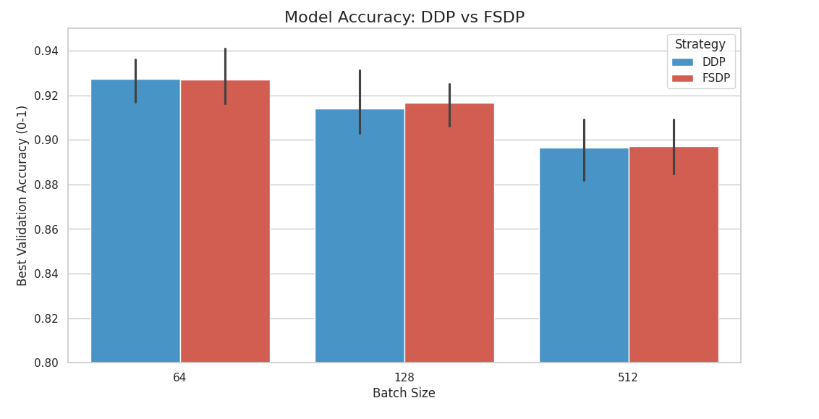
Model Accuracy (DDP vs FSDP)
Best DDP Acc: 93.62% (1 GPU | Batch 64)
Best FSDP Acc: 94.10% (1 GPU | Batch 64).

Slide 24
Future Scope
Mixed Precision (AMP): Use FP16 training to cut memory usage by 50%, enable much larger batch sizes (eg., 1024+) and faster DDP training
Richer Architectures: Scale CNN to ViTs / EfficientNet-B7 using FSDP to shard large models across GPUs
3D Histopathology: Extend pipeline to 3D volumetric data for more realistic tissue modeling using multi-GPU parallelism

Slide 25
Conclusion
Parallelism Works: Achieved up to 3.7x speedup using pytorch DDP on 4 GPUs
Accuracy vs Speed Trade-Off: Distributed training accelerates experimentation, but single GPU + Batch 64 delivered the best diagnostic accuracy (94%)
DDP vs FSDP: for this CNN-scale model, DDP outperformed FSDP in raw throughput, as sharding overhead wasn’t justified by memory needs.

Slide 26
Thank You

